Slide 1
Unit – 3 ASP.NET - I
References:
https://dotnet.microsoft.com

Slide 2
Introduction to ASP.NET
ASP.NET is an open source web framework, created by Microsoft, for building modern web apps and services with .NET.
ASP.NET is cross platform and runs on Windows, Linux, macOS, and Docker.
ASP.NET extends the .NET platform with tools and libraries specifically for building web apps.
ASP.NET was first released in the year 2002.
The full form of ASP is Active Server Pages

Slide 3
Introduction to ASP.NET
These are some things that ASP.NET adds to the .NET platform:
  Base framework for processing web requests in C# or F#
  Web-page templating syntax, known as Razor, for building dynamic web pages using C#
  Libraries for common web patterns, such as Model View Controller (MVC)
  Authentication system that includes libraries, a database, and template pages for handling logins, including multi-factor authentication and external authentication with Google, Twitter, and more.
  Editor extensions to provide syntax highlighting, code completion, and other functionality specifically for developing web pages

Slide 4
Clients and Servers
The internet consists of two types of computers; Servers and Clients.
Computers which offers information to be read are called servers.
Servers run special software called web server software that allows them to respond to client requests for information and accept data from clients.
Some of the most popular software which servers run to allow them to respond to client requests for information is Internet Information Server (IIS), Apache Web Server, Microsoft Personal Web Server, etc.

Slide 5
Clients and Servers
Computers that read the information offered are called clients.
Clients run special software called browser software that allows them to locate the appropriate server and query the server for the information to be read.
Some of the most popular browser software that clients run, to allow them to query internet servers for information are Netscape, internet explorer, etc.

Slide 6
World Wide Web
The WWW is a worldwide information service on the internet.
The WWW users browser, TCP/IP, HTTP and a web server to function.
TCP/IP is a communication protocol used by internet and is a must for WWW to function.
HTTP is the protocol used by the WWW service to make communication possible between a web server and a web browser.

Slide 7
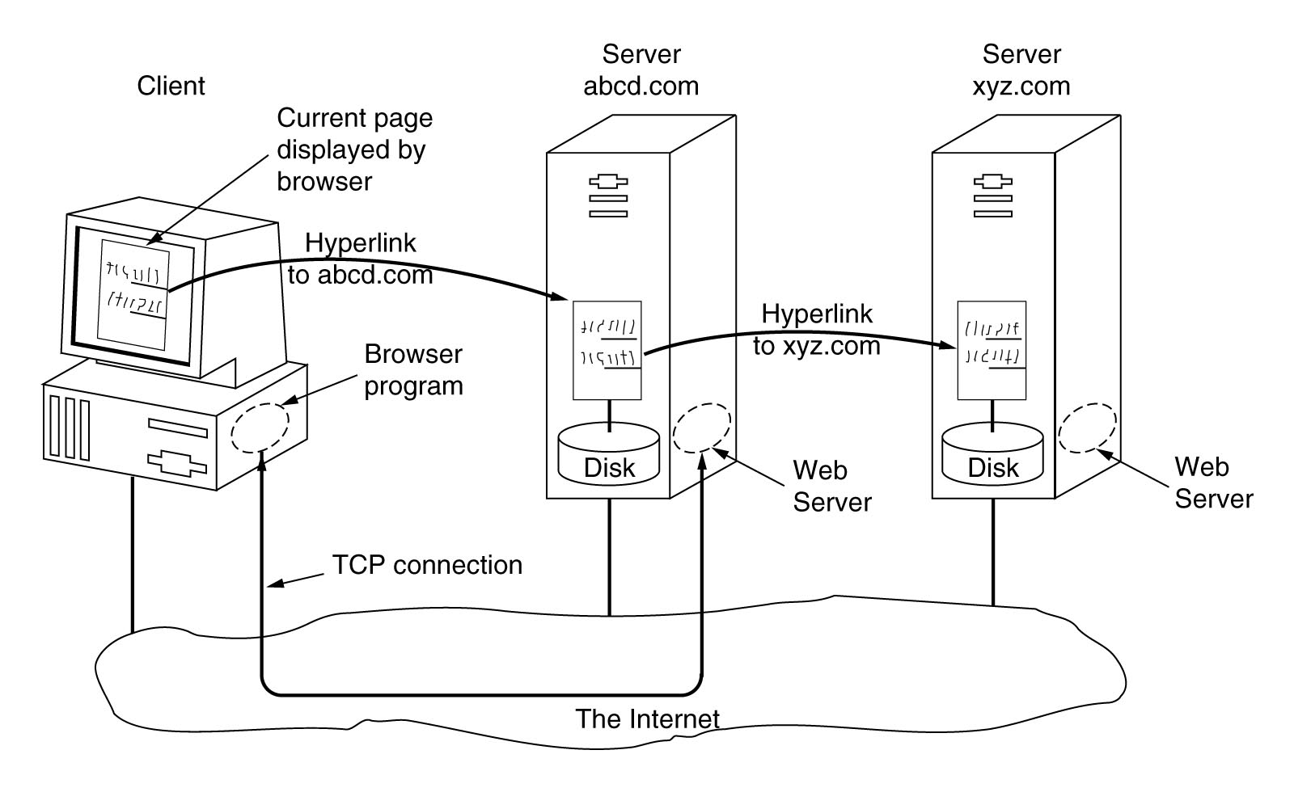
World Wide Web Model

Slide 8
Web Applications
A web application is an application installed only on the web server which is accessed by the users using a web browser.
There are also some other technology like Java, PHP, Perl, Ruby on Rails, etc. which can be used to develop web applications.
Web applications provide the cross-platform feature.
The user needs only a web browser to access a web application.

Slide 9
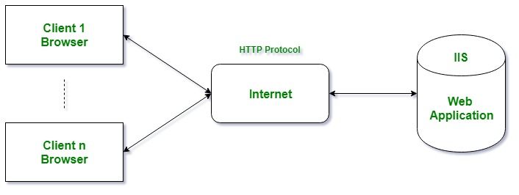
Web Applications
The web applications which are developed using the .NET framework or its subsets required to execute under the Microsoft Internet Information Services(IIS) on the server side.

Slide 10
Characteristics of the ASP.NET Framework
Code Behind Mode – This is the concept of separation of design and code.
  By making this separation, it becomes easier to maintain the ASP.Net application.
  The general file type of an ASP.Net file is aspx.
  Assume we have a web page called MyPage.aspx.
  There will be another file called MyPage.aspx.cs which would denote the code part of the page.
  So Visual Studio creates separate files for each web page, one for the design part and the other for the code.

Slide 11
Characteristics of the ASP.NET Framework
State Management – ASP.Net has the facility to control state management.
  For example, in a shopping cart application, when a user decides what he wants to buy from the site, he will press the submit button.
  The application needs to remember the items the user choose for the purchase.
  This is known as remembering the state of an application at a current point in time.
  HTTP is a stateless protocol. When the user goes to the purchase page, HTTP will not store the information on the cart items.
  Additional coding needs to be done to ensure that the cart items can be carried forward to the purchase page.
  Such an implementation can become complex at times. But ASP.Net can do state management on your behalf.
  So ASP.Net can remember the cart items and pass it over to the purchase page.

Slide 12
Characteristics of the ASP.NET Framework
Caching – ASP.Net can implement the concept of Caching. This improves the performance of the application.
  By caching those pages which are often requested by the user can be stored in a temporary location.
  These pages can be retrieved faster and better responses can be sent to the user.
  So caching can significantly improve the performance of an application.

Slide 13
ASP.NET Page
An ASP.NET page is made up of a number of server controls along with HTML controls, text, and images.
ASP.NET runtime controls the association between a page instance and its state.
An ASP.NET page is an object of the Page or inherited from it
All the controls on the pages are also objects of the related control class inherited from a parent Control class

Slide 14
ASP.NET Page
An ASP.NET page is also a server side file saved with the .aspx extension.
It is modular in nature and can be divided into the following core sections:
  Page Directives
  Code Section
  Page Layout

Slide 15
ASP.NET Page
Page Directives:
  The page directives set up the environment for the page to run.
  The @Page directive defines page-specific attributes used by ASP.NET page parser and compiler.
  Page directives specify how the page should be processed, and which assumptions need to be taken about the page.
  It allows importing namespaces, loading assemblies, and registering new controls with custom tag names and namespace prefixes.

Slide 16
ASP.NET Page
Code Section:
  The code section provides the handlers for the page and control events along with other functions required.
  The kind of response the events need to reciprocate is coded in the event handler functions.
  The event handlers are nothing but functions bound to the controls.
  The page code could be precompiled and deployed in the form of a binary assembly.

Slide 17
ASP.NET Page
Page Layout:
  The page layout provides the interface of the page. It contains the server controls, text, inline JavaScript, and HTML tags.

Slide 18
ASP.NET Page Life Cycle
When a page is requested, it is loaded into the server memory, processed, and sent to the browser.
Then it is unloaded from the memory.
At each of these steps, methods and events are available, which could be overridden according to the need of the application.
The Page class creates a hierarchical tree of all the controls on the page.

Slide 19
ASP.NET Page Life Cycle
The page life cycle phases are:
  Initialization
  Instantiation of the controls on the page
  Restoration and maintenance of the state
  Execution of the event handler codes
  Page rendering

Slide 20
ASP.NET Page Life Cycle
Following are the different stages of an ASP.NET page:
Page request
  When ASP.NET gets a page request, it decides whether to parse and compile the page, or there would be a cached version of the page; accordingly the response is sent.

Slide 21
ASP.NET Page Life Cycle
Starting of page life cycle
  At this stage, the Request and Response objects are set.
  If the request is an old request or post back, the IsPostBack property of the page is set to true.
Page initialization
  At this stage, the controls on the page are assigned unique ID by setting the UniqueID property and the themes are applied.
  For a new request, postback data is loaded and the control properties are restored to the view-state values.

Slide 22
ASP.NET Page Life Cycle
Page load
  At this stage, control properties are set using the view state and control state values.
Validation
  Validate method of the validation control is called and on its successful execution, the IsValid property of the page is set to true.
Postback event handling
  If the request is a postback (old request), the related event handler is invoked.

Slide 23
ASP.NET Page Life Cycle
Page rendering
  At this stage, view state for the page and all controls are saved.
  The page calls the Render method for each control and the output of rendering is written to the OutputStream class of the Response property of Page.
Unload
  The rendered page is sent to the client and page properties, such as Response and Request, are unloaded and all cleanup done.

Slide 24
HTML Controls vs. ASP.Net Controls
HTML Controls | ASP.Net Controls
HTML control runs at client side. | ASP.Net controls run at server side.
You can run HTML controls at server side by adding attribute runat=”server”. | You can not run ASP.Net Controls on client side as these controls have this attribute runat=”server” by default.
HTML controls are client side controls, so it does not provide STATE management. | ASP.Net Controls are Server side controls, provides STATE management.
HTML control does not require rendering. | ASP.Net controls require rendering.
As HTML controls runs on client side, execution is fast. | As ASP.Net controls run on server side, execution is slow.
HTML controls do not have any separate class for its controls. | ASP.Net controls have separate class for its each control.
HTML controls does not support Object Oriented paradigm. | With ASP.Net controls, you have full support of Object oriented paradigm.
HTML controls can not be accessed form code behind files. | ASP.Net controls can be directly worked and accessed from code behind files.
HTML control have limited set of properties and/or methods. | ASP.Net controls have rich set of properties and/or methods.
Enter Name : <input type="text" ID="txtName"> | Enter Name : <asp:TextBox Id="txtName" runat="server"> </asp:TextBox>

Slide 25
PostBack
PostBack is the name given to the process of submitting an ASP.NET page to the server for processing.
Postback is actually sending all the information from client to web server, then web server process all those contents and returns back to the client.
PostBack is done if certain credentials of the page are to be checked against some sources (such as verification of username and password using database).

Slide 26
IsPostback Property
IsPostBack is a property of the Asp.Net page that tells whether or not the page is on its initial load or if a user has perform a button on your web page that has caused the page to post back to itself.
The value of the Page.IsPostBack property will be set to true when the page is executing after a postback, and false otherwise.
We can check the value of this property based on the value and we can populate the controls on the page.
IsPostback is normally used on page _load event to detect if the web page is getting generated due to postback requested by a control on the page or if the page is getting loaded for the first time.

Slide 27
AutoPostBack Property
AutoPostBack property allows controls which cannot submit the Form (PostBack) on their own and hence ASP.Net has provided a feature using which controls like DropDownList, CheckBoxList, RadioButtonList, etc. can perform PostBack.
The AutoPostBack property is used to set or return whether or not an automatic post back occurs when the user selects an item in a list control.
If this property is set to TRUE the automatic post back is enabled, otherwise FALSE.
It allows to submit ASP.NET page to the server without clicking submit button.

Slide 28
Basic Controls
Button Controls: ASP.NET provides three types of button control:
  Button : It displays text within a rectangular area.
  Link Button : It displays text that looks like a hyperlink.
  Image Button : It displays an image.
Text Boxes and Labels: Text box controls are typically used to accept input from the user.
  A text box control can accept one or more lines of text depending upon the settings of the TextMode attribute.
  Label controls provide an easy way to display text which can be changed from one execution of a page to the next.
  If you want to display text that does not change, you use the literal text.

Slide 29
Basic Controls
Check Boxes and Radio Buttons
  A check box displays a single option that the user can either check or uncheck and radio buttons present a group of options from which the user can select just one option.
  To create a group of radio buttons, you specify the same name for the GroupName attribute of each radio button in the group.
  If you want check box or radio button to be selected when the form is initially displayed, set its Checked attribute to true.
  If the Checked attribute is set to true for multiple radio buttons in a group, then only the last one is considered as true.

Slide 30
Basic Controls
List Controls: ASP.NET provides the following controls
  Drop-down list
  List box
  Radio button list
  Check box list
These control let a user choose from one or more items from the list.
List boxes and drop-down lists contain one or more list items.
These lists can be loaded either by code or by the ListItemCollection editor.

Slide 31
Basic Controls
HyperLink Control
  The HyperLink control is like the HTML <a> element.
Image Control
  The image control is used for displaying images on the web page, or some alternative text, if the image is not available.

Slide 32
Connecting Pages
HyperLink control and LinkButton control are used to give link between pages.
The HyperLink control immediately navigates to the target URL when the user clicks on the control.
  The form is not posted to the server.
The LinkButton control first posts the form to the server, then navigates to the URL.
  If you need to do any server-side processing before going to the target URL, use a LinkButton.

Slide 33
AdRotator Control
AdRotator control is used to display a sequence of ad images.
This control uses an XML file to store the ad information. The XML file must begin and end with an <Advertisements> tag.
Inside the <Advertisements> tag there may be several <Ad> tags which defines each ad.
One should use the predefined elements inside the <Ad> tag which are given in properties of the control.

Slide 34
Master Pages
ASP.NET master pages enable you to create a page layout (a master page) that you can use with selected or all pages (content pages) in your Web site.
A single master page defines the look and feel and standard behavior that you want for all of the pages (or a group of pages) in your application.
You can then create individual content pages that contain the content you want to display.
When users request the content pages, they merge with the master page to produce output that combines the layout of the master page with the content from the content page.

Slide 35
Master Pages
Master pages actually consist of two pieces, the master page itself and one or more content pages.
A master page is an ASP.NET file with the extension .master.
In addition to static text and controls that will appear on all pages, the master page also includes one or more ContentPlaceHolder controls.
These placeholder controls define regions where replaceable content will appear.
In turn, the replaceable content is defined in content pages.

Slide 36
Content Page
You define the content for the master page's placeholder controls by creating individual content pages, which are ASP.NET pages (.aspx files and code-behind files) that are bound to a specific master page.
The binding is established in the content page's @ Page directive by including a MasterPageFile attribute that points to the master page to be used.
In the content page, you create the content by adding Content controls and mapping them to ContentPlaceHolder controls on the master page.
In a content page, anything that is not inside the Content controls (except script blocks for server code) results in an error.

Slide 37
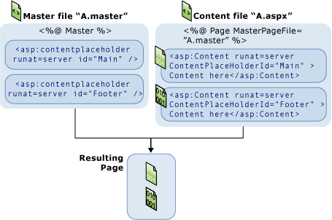
Execution of Master Page

Slide 38
Execution of Master Page
Users request a page by typing the URL of the content page.
When the page is fetched, the @ Page directive is read.
  If the directive references a master page, the master page is read as well.
  If this is the first time the pages have been requested, both pages are compiled.
The master page with the updated content is merged into the control tree of the content page.
The content of individual Content controls is merged into the corresponding ContentPlaceHolder control in the master page.
The resulting merged page is rendered to the browser.

Slide 39
Themes and Skins
ASP.NET themes are a collection of properties that define the appearance of pages and controls in your Web site.
A theme can include skin files, which define property settings for ASP.NET Web server controls, and can also include cascading style sheet files (.css files) and graphics.
By applying a theme, you can give the pages in your Web site a consistent appearance.

Slide 40
Themes and Skins
Steps of creating Page Theme:
In Solution Explorer, right-click the name of the Web site for which you want to create a page theme, and then click Add ASP.NET Folder.
Click Theme.
  If the App_Themes folder does not already exist, Visual Web Developer creates it.
  Visual Web Developer then creates a new folder for the theme as a child folder of the App_Themes folder.
Type a name for the new folder.
  The name of this folder is also the name of the page theme.
  For example, if you create a folder named \App_Themes\FirstTheme, the name of your theme is FirstTheme.
Add files to your new folder for control skins, style sheets, and images that make up the theme.

Slide 41
Themes and Skins
Steps to add a skin file and a skin to a page theme:
In Solution Explorer, right-click the name of your theme and then click Add New Item.
In the Add New Item dialog box, click Skin File.
In the Name box, type a name for the .skin file, and then click Add.
  The typical convention is to create one .skin file per control, such as Button.skin or Calendar.skin.
  However, you can create as many or as few .skin files as you need.
In the .skin file, add a normal control definition by using declarative syntax, but include only the properties that you want to set for the theme.
  The control definition must include the runat="server" attribute, and it must not include the ID="" attribute.
  You can define only one default skin per control.
  Use the SkinID attribute in the skin's control declaration to create named skins for the same type of control.

